Slide 1
Chapter 6 Chemistry Stoichiometry
Wilt Gu

Slide 2
What is stoichiometry?
Stoichiometry is the quantitative study of reactants and products in a chemical reaction.

Slide 3
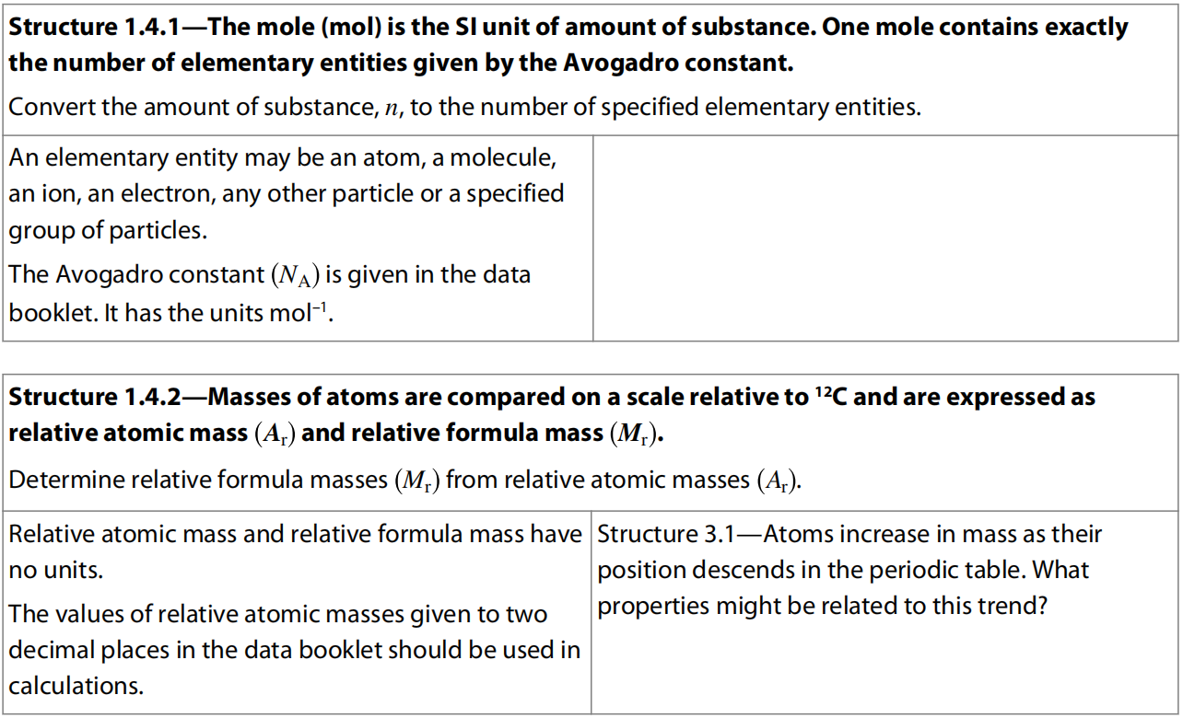
6.1 Counting particles by mass: The mole

Slide 4
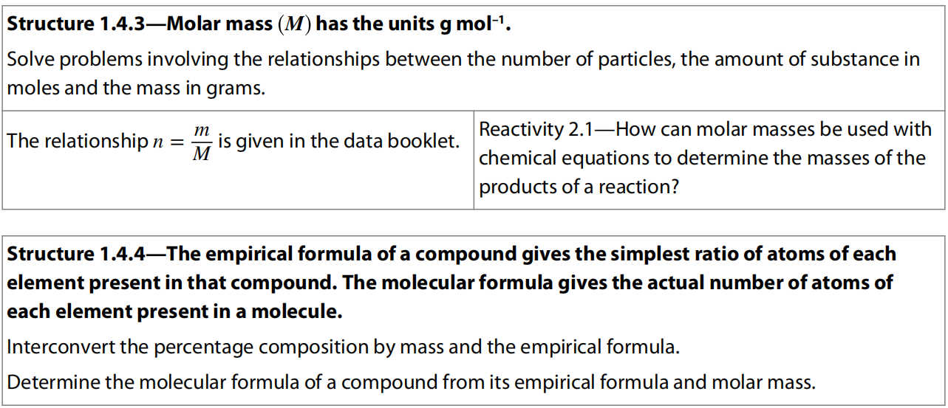
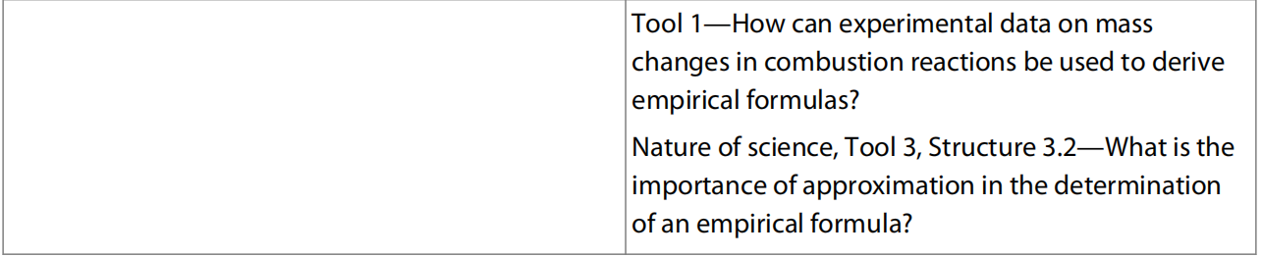

Slide 5
Avogadro Constant and the Mole
The number, accurately stated as 6.02214129 × 10²³, is known as the Avogadro number, and it is the basis of the unit of amount used in chemistry known as the mole.
Mole, the unit of amount, is one of the base units in the SI system and has the unit symbol mol.
So the Avogadro constant, 6.02 × 10²³, is the number of particles in one mole of a substance and has the units mol^{–1}.

Slide 6
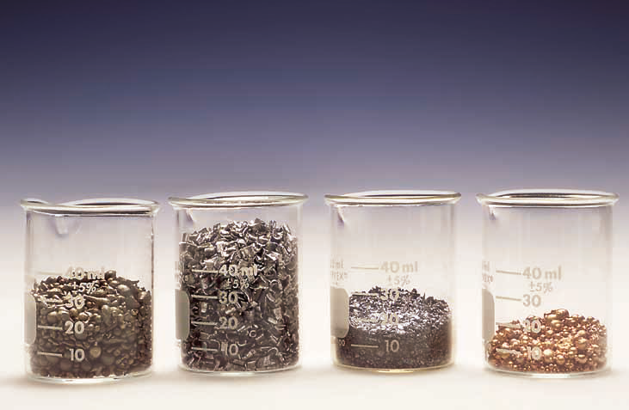
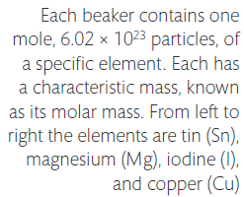

Slide 7
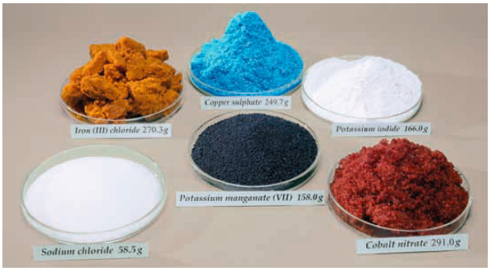
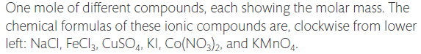

Slide 8
Calculations between number of particles & number of moles (amount of substances)

Slide 9
Relative atomic mass
Relative atomic mass, A_{r}, is the weighted average of one atom of an element relative to one-twelfth of an atom of carbon-12.
It is a relative mass so there is no unit.
Normally most elements have 2 or more isotopes, so the relative atomic masses of almost all the elements are NOT whole number.
In chemistry calculation, we normally use the A_{r} to the second decimal place (some elements in the back of the table are used their A_{r} to the first decimal place).

Slide 11
Relative formula mass
We can extend the concept of relative atomic mass to compounds (and to elements occurring as molecules), to obtain the relative formula mass, M_{r}.
This simply involves adding the relative atomic masses of all the atoms or ions present in its formula.
Note that M_{r}, like A_{r}, is a relative term and so has no units.

Slide 12
Molar Mass
The Avogadro number is defined so that the mass of one mole of a substance is exactly equal to the substance’s relative atomic mass expressed in grams.
This is known as the molar mass and is given the symbol M with the unit g mol^{–1}, which is a derived SI unit.

Slide 14
Calculation of molar mass and number of moles

Slide 15
Combined calculations

Slide 16
Empirical Formula
Empirical formula is the formula that gives the simplest whole number ratio of the elements in a compound.

Slide 18
The empirical formula questions
Calculation processes:
1. Convert the mass of each element to moles by dividing by its molar mass, M.
2. Divide by the smallest number to give the ratio.
3. Approximate to the nearest whole number (BE AWARE of this step).

Slide 20
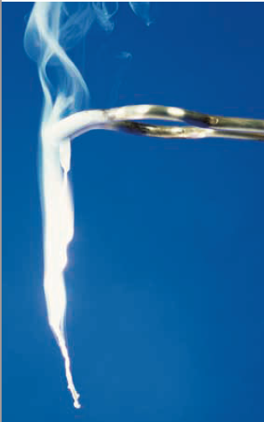
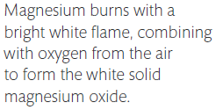
Determine the empirical formula of magnesium oxide.
How would you design this experiment?

Slide 21
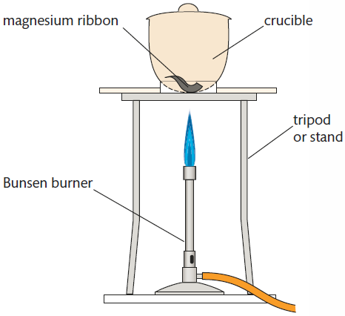
Determine the empirical formula of an oxide of magnesium.

Slide 22
Experiment to determine the empirical formula of MgO
A sample of magnesium is heated and the change in mass recorded. From this, the ratio of moles of magnesium to oxygen can be determined.

Slide 23
Ratio moles Mg : moles O = 1 : 1.02
So the ratio atoms Mg : atoms O approximates to 1 : 1
So the formula of magnesium oxide is MgO.

Slide 24
The fact that the experimental result is not exactly 1 : 1 indicates there are some errors in the experiment. We can consider possible systematic errors here, such as:
the Mg weighed is not all pure;
not all the Mg weighed reacted;
the product was not magnesium oxide only;
loss of Mg or of product occurred;
change in the mass of the crucible occurred during handling and heating.
Modifications to the experimental design can be considered, which help to reduce the experimental error.

Slide 25
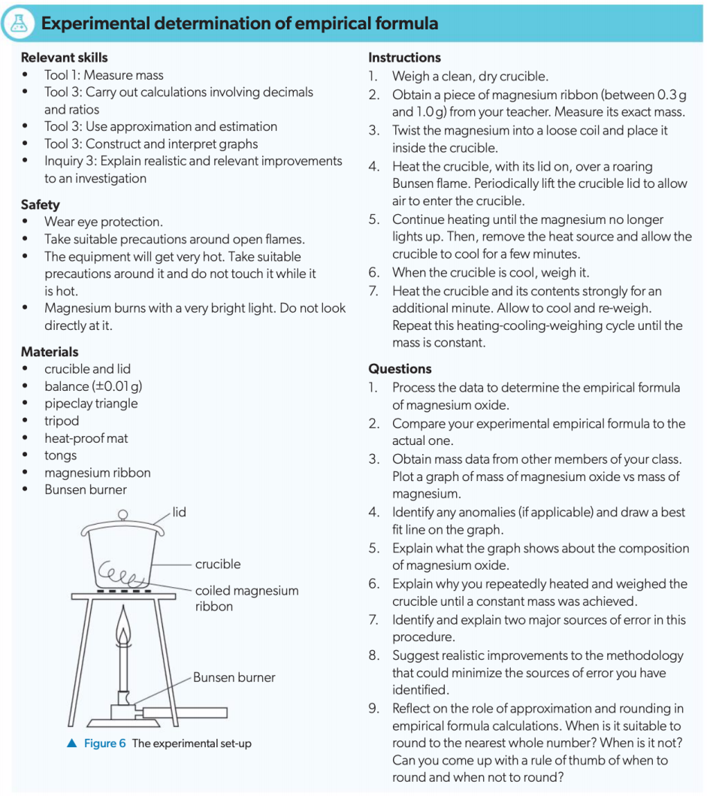

Slide 26
Mass composition
Calculation processes:
1. Assume the M_{r} of the compound to be 100
2. then divide the mass compositions of different elements by their A_{r}
3. then divide these numbers with the smallest one to work out the whole number ratio of the elements involved.
Applications: hydrated and anhydrous salts, chemical fertilizers

Slide 27
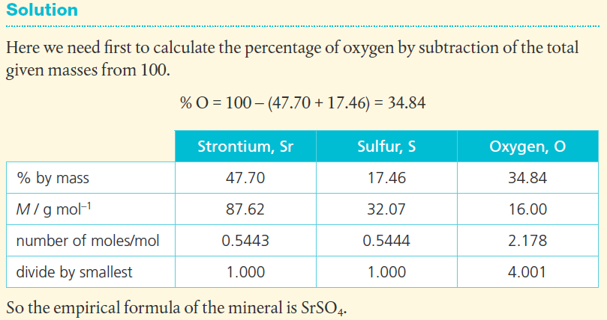

Slide 29
Hydrated Salt
A modification of this type of question is to analyse the composition of a hydrated salt.
These are compounds that contain a fixed ratio of water molecules, known as water of crystallization, within the crystalline structure of the compound.
The water of crystallization can be driven off by heating, and the change in mass used to calculate the ratio of water molecules to the anhydrous salt.

Slide 30
The formula of the hydrated salt is shown with a dot before the number of molecules of water, for example CaCl₂·4H₂O.
Percentage data effectively give us the mass present in a 100 g sample of the compound.
It is common for the composition data to be given in the form of percentages by mass, and we use these figures in the same way to deduce the ratio of atoms present.

Slide 31
Molecular formula
Molecular formula: Formula which shows all the atoms present in a molecule.
The molecular formula can be deduced from the empirical formula if the molar mass is known.
x (mass of empirical formula) = M
where x is an integer

Slide 33
Combustion analysis
When combusted, elements in a compound are normally converted into new compounds, typically their oxides, by reaction with oxygen.
So the primary data obtained are the masses of carbon dioxide, water, sulfur dioxide, and so on.
These can also be used to deduce the empirical formula of a compound.

Slide 37
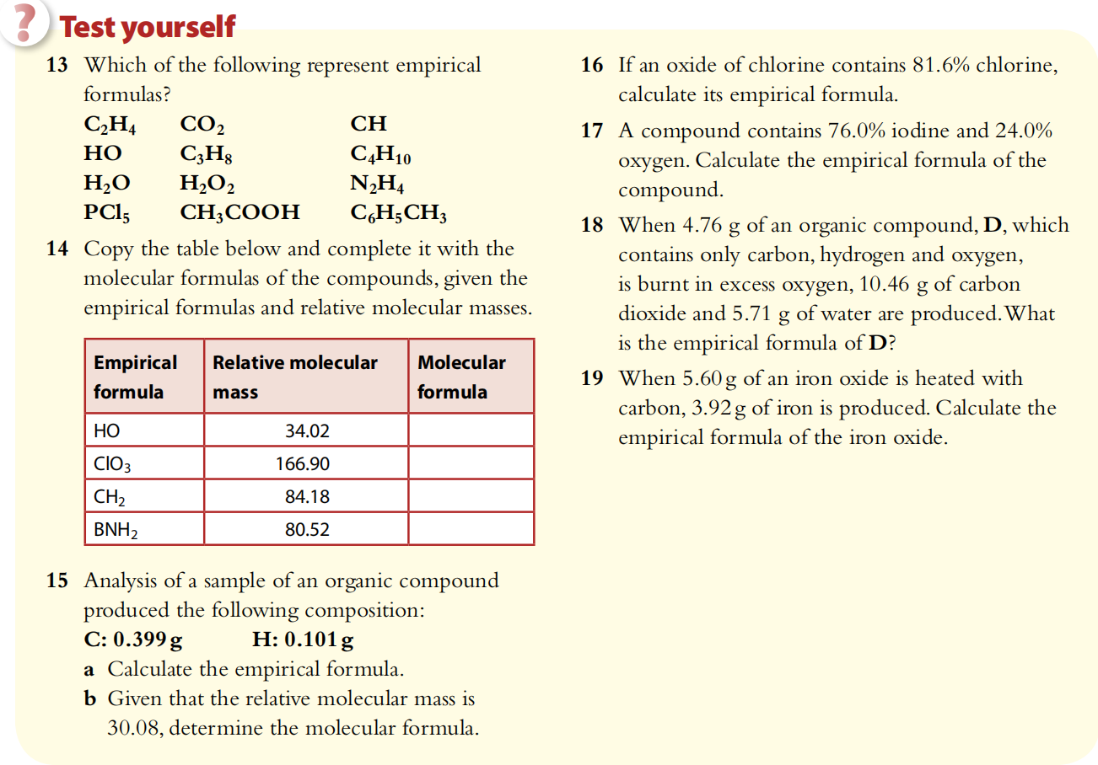

Slide 38
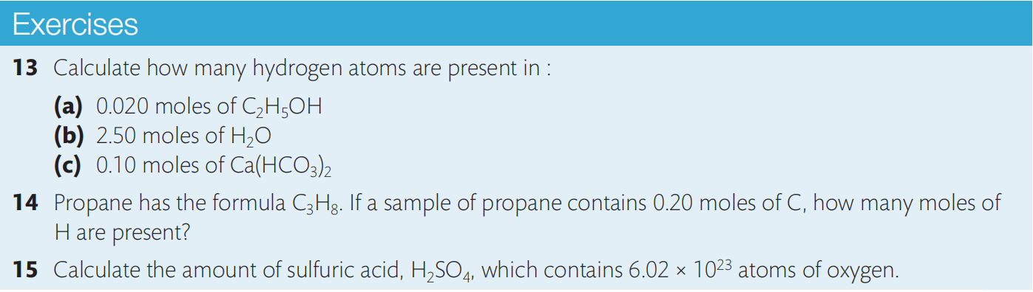
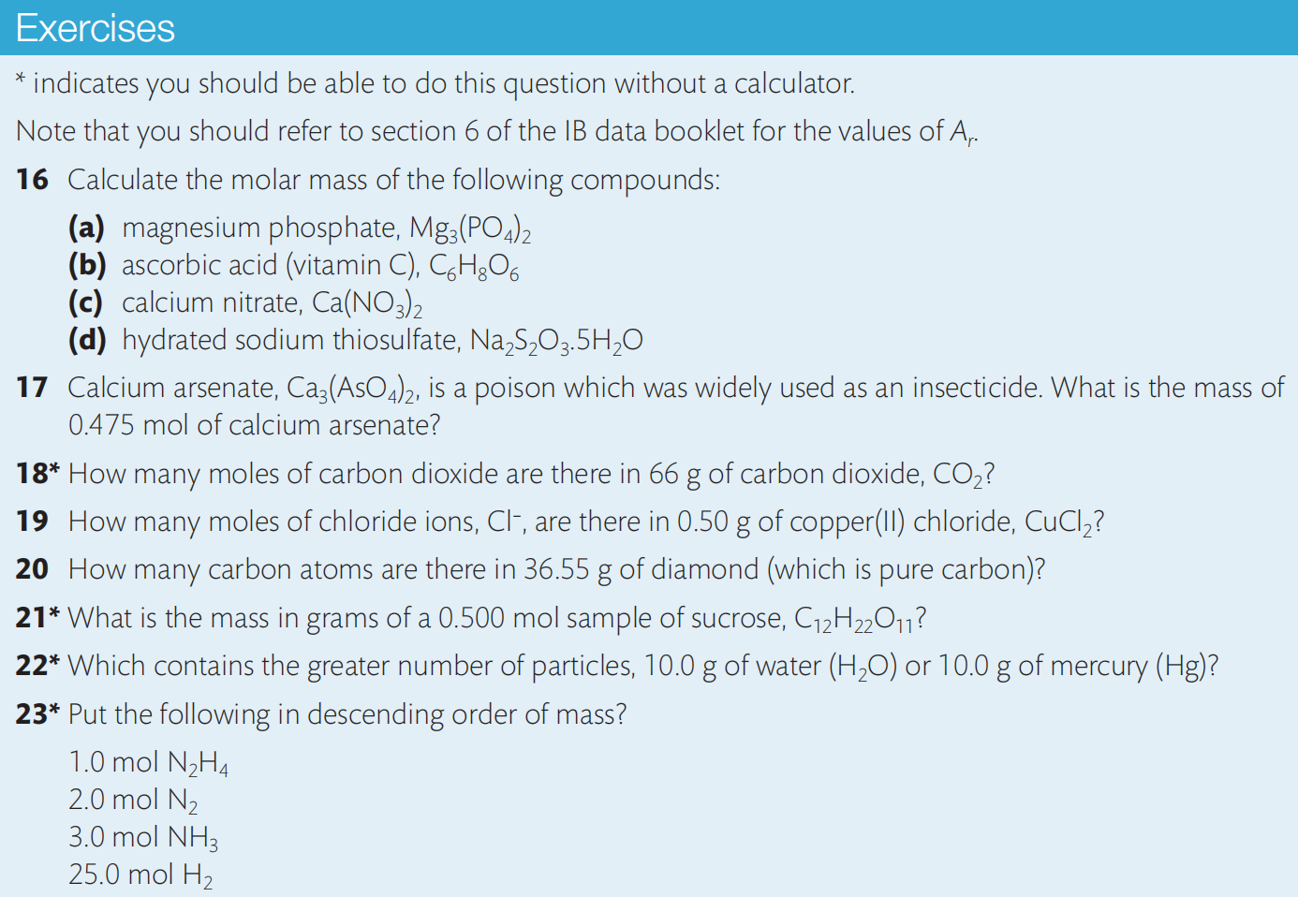

Slide 39
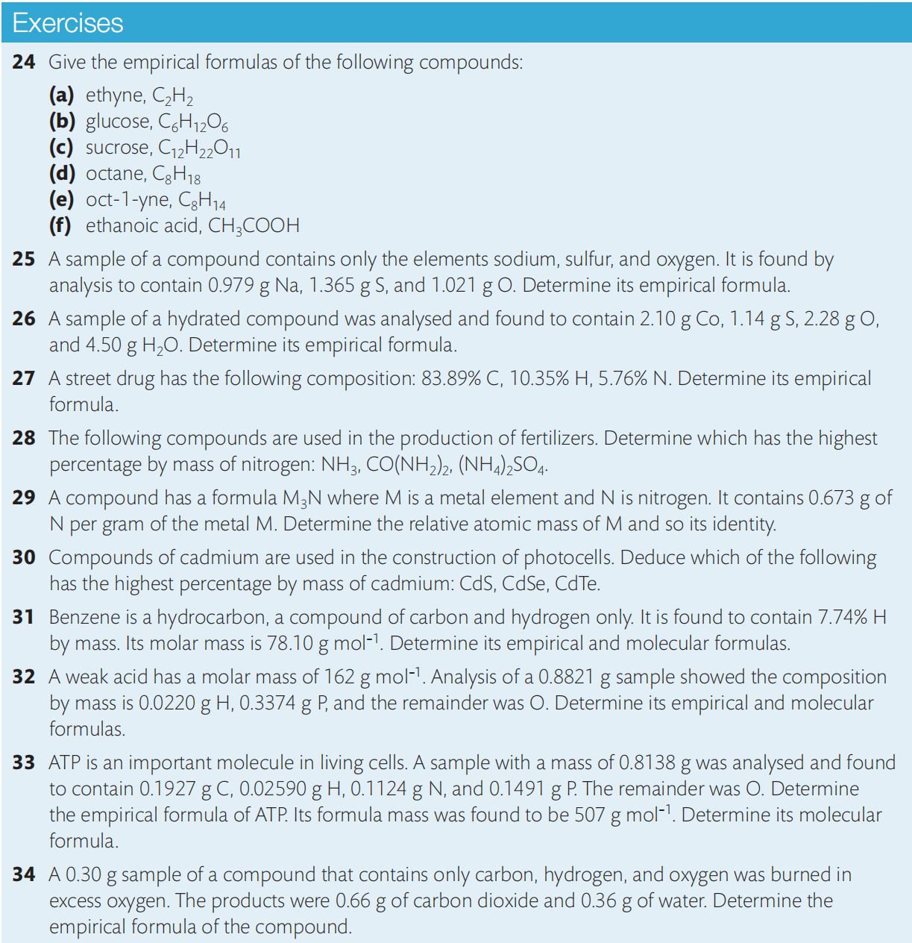

Slide 41
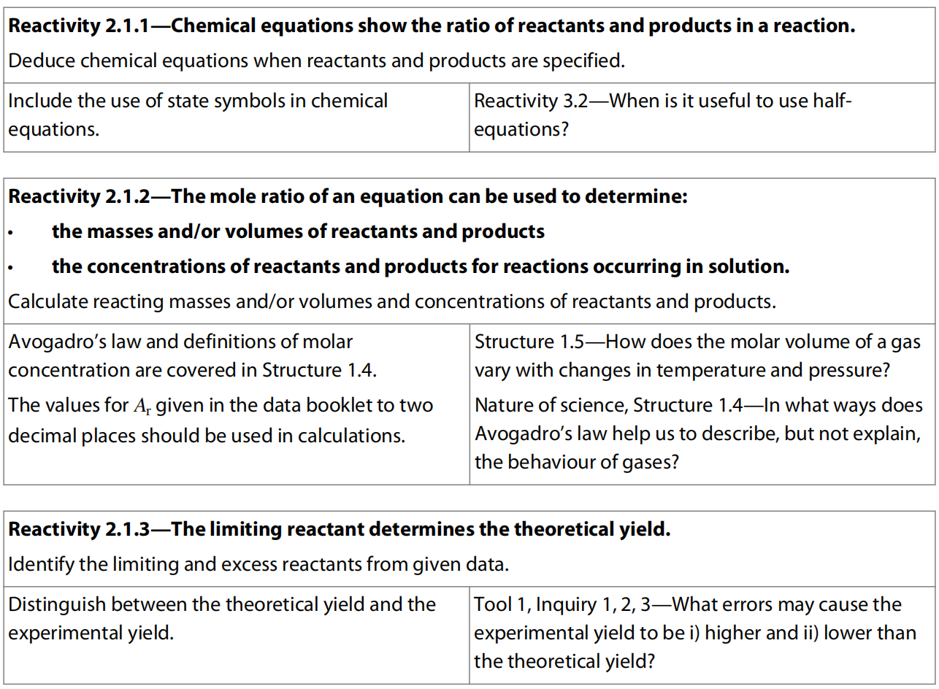
6.2 Molar ratio and chemical equations

Slide 42
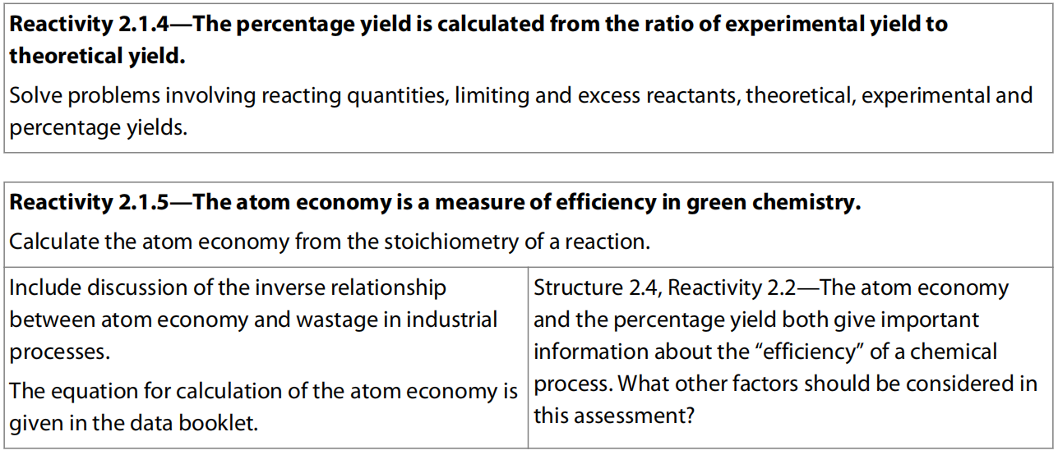

Slide 43
Chemical Equations
Chemical change, as summarized in chemical equations, is simply an expression of reactants combining in fixed ratios to form products.
The most convenient means to express this ratio is as moles, as that gives us a means of relating the number of particles that react to the mass that we can measure.

Slide 44
Coefficient ratio
The coefficient ratio of a balanced equation equals to the molar ratio (not the mass ratio) of the substances involved in the reaction.

Slide 45
mole of CH₄ = 1.00/16.05 = 0.0623 mol
Construct an equation showing mole of 1 substance over its coefficient equals to that of other substance(s).
0.0623/1 = x/1
mol of CO₂ = x = 0.0623 mol
mass of CO₂ = x/44.01 = 2.74 g

Slide 46
All questions on reacting ratios involve a variation of this approach:
1. write the balanced equation;
2. work out the mole of any substances with given data (mass, volume of gas, concentration of solute, etc.)
3. Construct equation that connects different substances with their moles over their coefficients;
4. Work out mole of required unknown substance;
5. Calculate whatever the question requires afterwards.

Slide 48
Limiting Reactant
In many chemical reactions the relative amounts of reactants available to react together will similarly affect the amount of product.
The reactant that determines the quantity of product is known as the limiting reactant/limiting reagent.
Other reactants will therefore not be fully used, and are said to be in excess / excess reactant.
Identifying the limiting reactant is therefore a crucial step before we can calculate the expected quantity of product.

Slide 49
Determining Limiting Reactant
Calculate the mole of both/all the reactants;
Divide the mole of each reactant by its coefficient in the balanced equation;
The one with smallest quotient would be the limiting reactant;
All other reactants are in excess.
The mole of limiting reactant can be used to calculate the mole of excess reactants that are involved in the reaction.
The difference between the involved and the total excess reactants would give the amount in excess.

Slide 50
Theoretical yield
The theoretical yield (in grams or moles) refers to the maximum amount of product obtainable, assuming 100% of the limiting reactant is converted to product.
Note that identification of the limiting reactant depends on the mole ratios in the balanced chemical equation for the reaction.
This means that if reactant quantities are given in grams, they must first be converted to moles.

Slide 52
divide mol of NH3 by its coefficient and do the same for CuO:
NH₃: 1.06/2=0.53 mol of reaction equation
CuO: 1.14/3=0.38 mol of reaction equation
0.53>0.38
The smallest one (this can also be applied in reactions with more than 2 reactants) would be decided as the limiting reactant so in this case CuO is the limiting reactant.

Slide 54
We can also do the question like this:
n_{NH3} = 1.06mol, n_{CuO} = 1.14mol
2 NH₃ + 3 CuO → N₂ + 3 Cu + 3 H₂O
Initial mol 1.06 1.14 0 0 0
(Change₁ 1.06(limiting) 1.59 (more than 1.14 so not possible) )
Change₂ -0.76 -1.14 (limiting)
Final mol 0.30(remain) 0 0.38 1.14 1.14
Mass of remaining excess reactant and all products can then be easily calculated.

Slide 55
There are alternate approaches to determining the limiting reactant, such as calculating which given amount of reactant would yield the smallest amount of product.
But in essence, all questions on limiting reactant and theoretical yield involve comparing the mole ratio of given masses of reactants with the coefficients in the equation.

Slide 56
This is a summary of the steps:
1. write the balanced equation and focus on the mole ratio of reactants;
2. convert the given mass of reactants to moles;
3. divide the given moles by the coefficients for each reactant in the equation;
4. identify the limiting reactant that has the smallest quotient;
5. calculate the moles of product from the given moles of limiting reactant.

Slide 57
Experimental Yield
Theoretical yield assumes that all of the limiting reactant was converted to product with no loss, impurities present, wastage, or incomplete reaction.
In reality, all of the above happen to different extents in most chemical reactions, and so the theoretical yield is usually greater than the actual or experimental yield.

Slide 58
Percentage Yield
When we compare the experimental yield with the theoretical yield, we get a measure of the efficiency of the conversion of reactants to products.
This is usually expressed as the percentage yield, de ned as follows:

Slide 60
Green Chemistry
In traditional chemistry, the efficiency of a synthetic procedure is measured in terms of the product yield and the cost of raw materials.
Many other factors, such as the toxicity of reagents and solvents, energy consumption and the amount of waste produced are often ignored.
A completely different approach, known as green chemistry, takes into account the environmental impact of the entire technological process.
Green chemistry encourages scientists to minimize the use and generation of hazardous chemicals when designing reactions that are used in industrial processes.
Common practices of green chemistry include aqueous or solvent-free reactions, renewable starting materials, mild reaction conditions, efficient catalysis and the utilization of any by-products formed during the synthesis.

Slide 61
The Atom Economy
Another key concept of green chemistry is the atom economy, which is a measure of the efficiency of a reaction. The atom economy is the ratio of the mass of the isolated target product to the combined masses of all starting materials, catalysts and solvents used in the reaction:
Atom Economy = molar mass of desired product / total molar mass of reaction mixture × 100%

Slide 62
For example, the atom economy of a solvent-free reaction A + B → C is equal to the experimental yield and can potentially reach almost 100%.
However, in the reaction A + B → C + D, where C is the target product, the atom economy will always be significantly lower than 100% because the unwanted by-product D is formed.
The use of solvents and catalysts will further reduce the atom economy because their constituent atoms do not form the target product and must be disposed of or recycled. Therefore, the atom economy isinversely proportional to the percentage of waste generated in an industrial process or laboratory experiment.
The raised awareness of environmental protection and sustainable development led to the new concept of the atomic economy: using less materials to produce most products we desire.

Slide 63
Development of Green Chemistry
Green technologies vary in efficiency and in many cases involve expensive equipment, raw materials and recycling facilities.
However, these initial investments reduce the costs associated with environmental remediation, waste management and energy consumption.
Therefore, in the long term, green chemistry is a commercially attractive and sustainable alternative to traditional organic chemistry.

Slide 64
Increasing adoption of green industrial processes in developed countries has significantly reduced the emissions of many hazardous chemicals, such as chlorinated solvents or greenhouse gases.
At the same time, some non-hazardous substances branded as “green” or “environmentally friendly” still require toxic chemicals or large amounts of energy for their production.
The industrial use of natural products, such as plant oils and starch, takes up agricultural resources, reduces biodiversity and increases the cost of food. This can lead to various ecological and social issues.
Therefore, the “greenness” of a product must be assessed using all direct and indirect environmental implications of its entire life cycle. This is one of the most controversial problems in green chemistry.

Slide 65
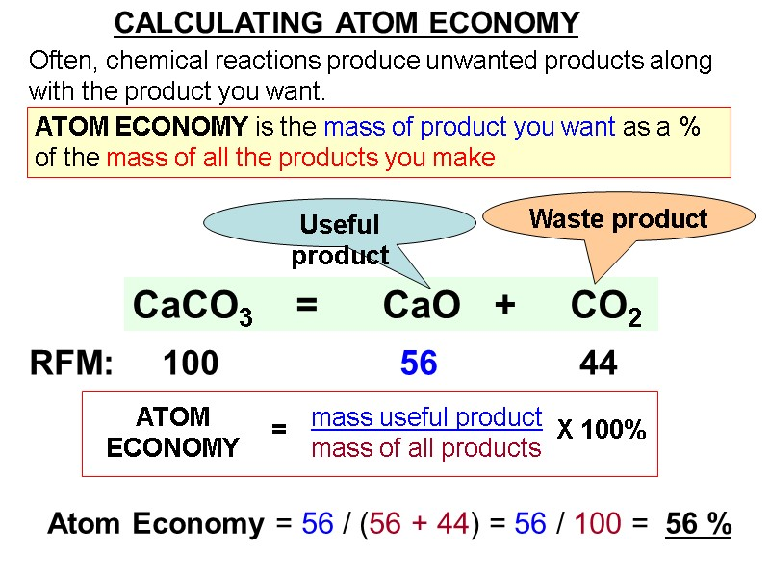

Slide 66
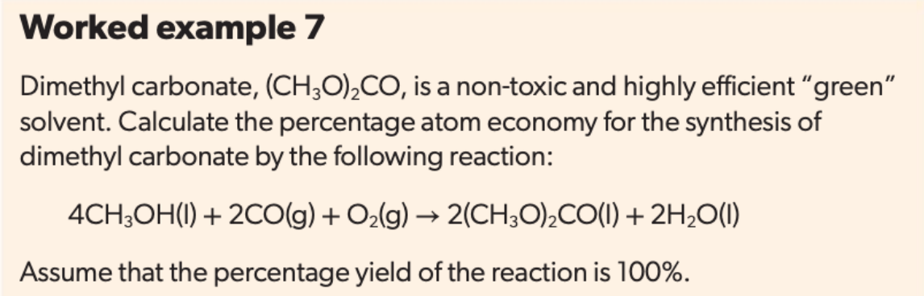
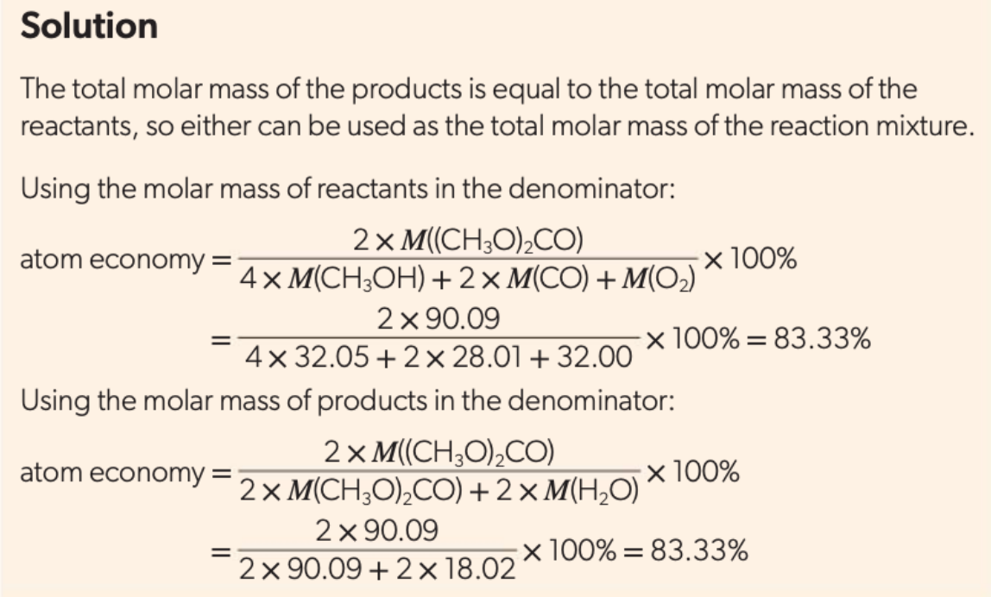

Slide 68
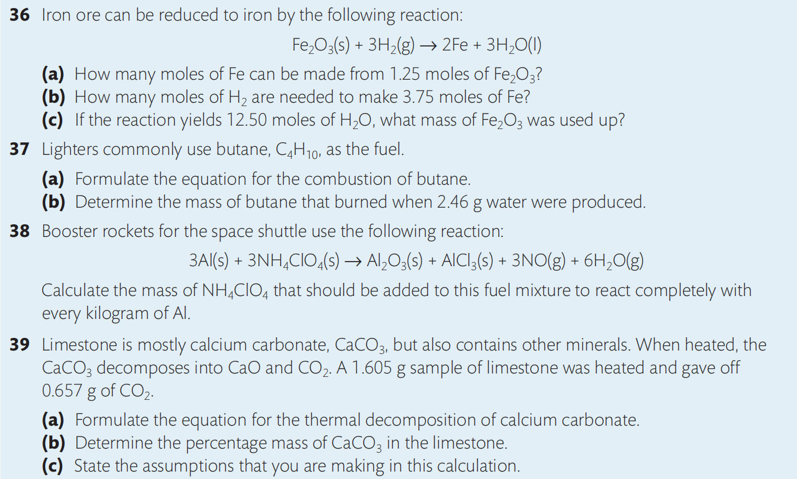

Slide 69
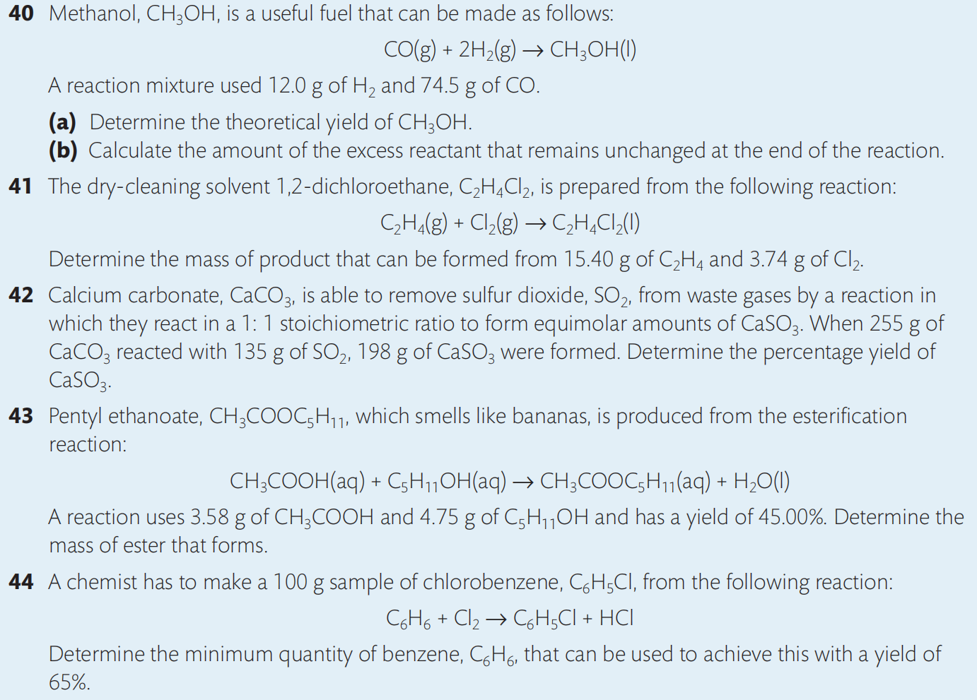

Slide 70
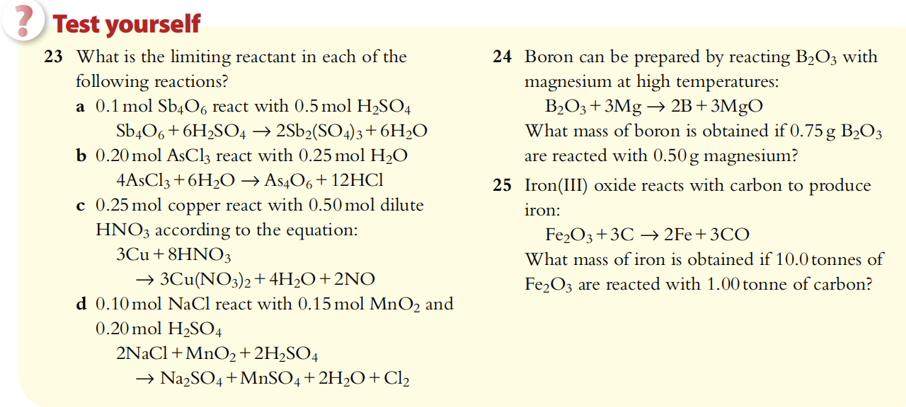

Slide 71
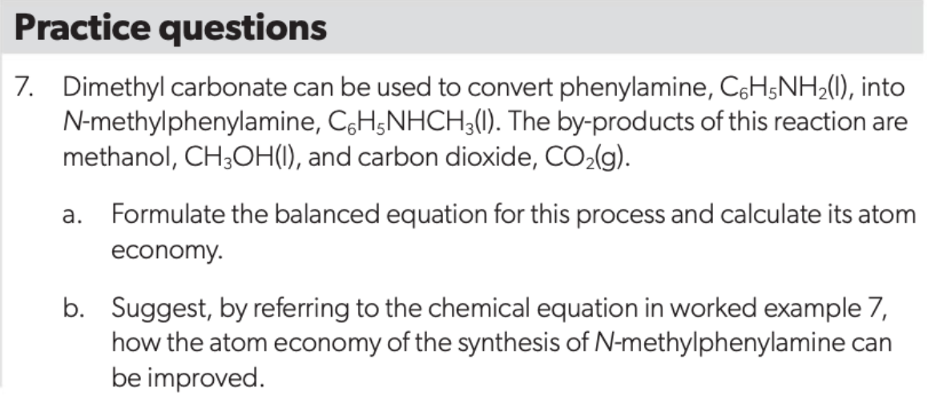

Slide 72
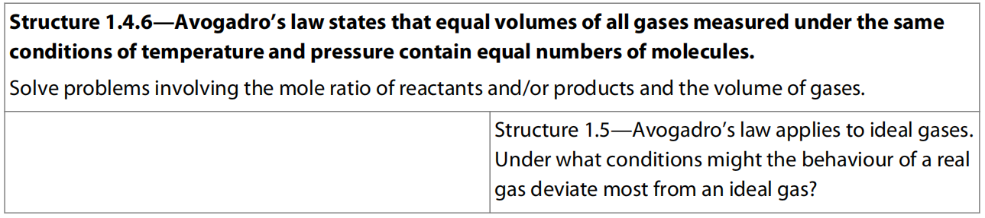
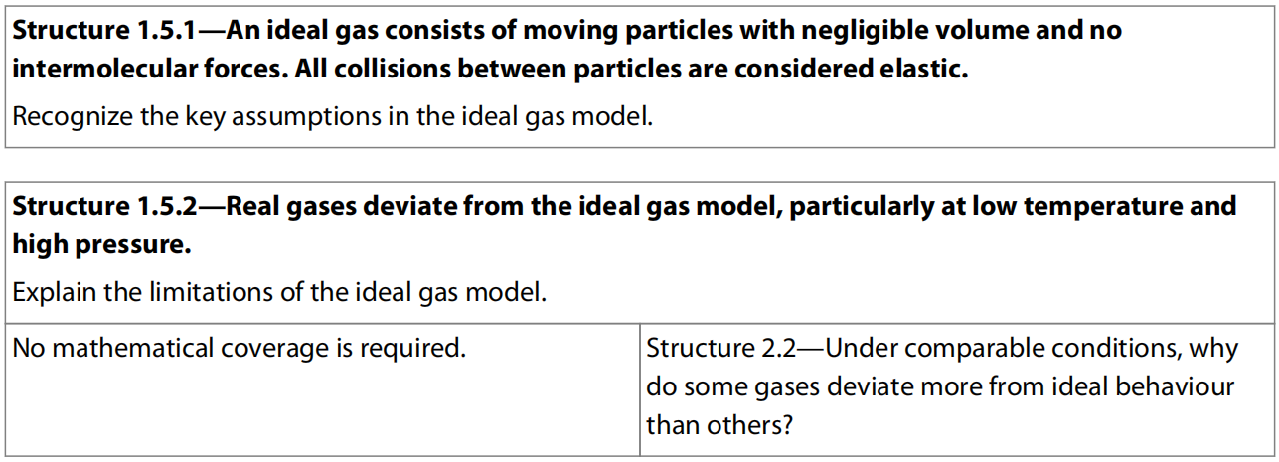
6.3 Ideal Gases

Slide 73
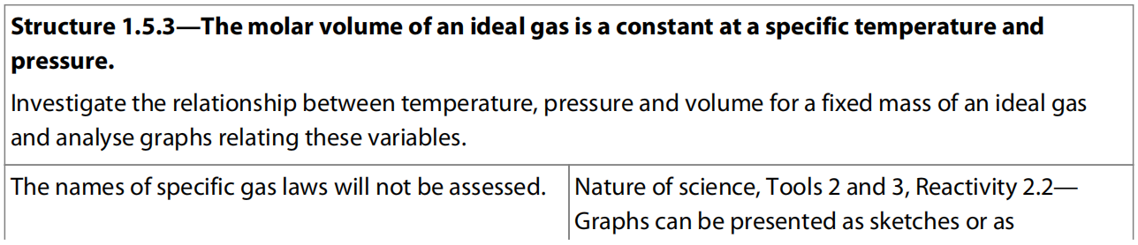
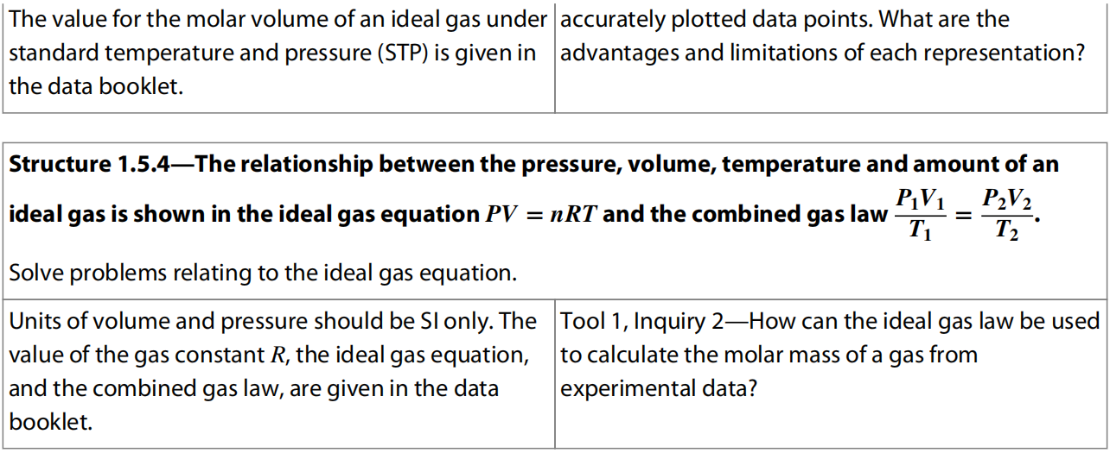

Slide 74
Avogadro’s Law
Equal volumes of all gases, when measured at the same temperature and pressure, contain an equal number of particles.
Avogadro’s Law: V₁/n₁ = V₂/n₂

Slide 77
Molar Volume
On the basis of Avogadro’s law, the volume occupied by one mole of any gas, known as the molar volume, must be the same for all gases when measured under the same conditions of temperature and pressure.
At standard temperature and pressure (STP), one mole of a gas has a volume of 22.7 dm³ mol^{–1}.
The conditions at STP are:
A temperature of 0°C (273 K)
Pressure of 100 kPa.

Slide 79
Boyle’s Law
If the temperature is held constant, it is found that increasing the pressure on a fixed mass of gas decreases its volume.
In other words, the pressure of a gas is inversely proportional to its volume, and the product of pressure and volume is a constant.
Boyle’s law: p₁V₁ = p₂V₂

Slide 80
Charles’ Law
An increase in temperature represents an increase in the average kinetic energy of the particles.
If the pressure is held constant, it is found that increasing the temperature of a fixed mass of gas increases its volume.
In other words, the volume of a gas is directly proportional to its absolute temperature, and volume divided by absolute temperature is a constant.
Charles’ law: V₁/T₁ = V₂/T₂

Slide 82
Gay Lussac’s Law
If the volume is held constant, it is found that increasing the temperature of a fixed mass of gas proportionately raises its pressure.
In other words, the pressure of a gas is directly proportional to the absolute temperature, and pressure divided by temperature is a constant.
Gay Lussac law: P₁/T₁ = P₂/T₂

Slide 84
The combined gas equation
Combine Gay Lussac Law with Charles’ Law, the following equation will be got:

Slide 87
The Ideal Gas Equation
The combined gas equation tells us that
PV/T = a constant
The value of the constant is directly proportional to the fixed mass of gas, or the number of moles, so PV/T ∝ n
This can be made into an equation by introducing a constant, R, known as the ideal gas constant.
PV/nT = R, which is usually written as PV = nRT
This equation is known as the ideal gas equation, and is given in Section 1 of the IB data booklet.

Slide 88
The value of R can be calculated by substituting known values into the equation, such as those for the molar volume of a gas at STP.
In this case:
P = 100 kPa, V = 22.7 dm³, T = 273 K, n = 1 mol
R = 8.31 N m K^{–1} mol^{–1} or 8.31 J K^{–1} mol^{–1}
This value for R, the gas constant, is given in Section 2 in the IB data booklet and should be used for all calculations involving the ideal gas equation.

Slide 89
The value of R could change if the unit of any other things in the equation being changed, so it is needed to make sure that the following items have their corresponding units to make R = 8.31:
Pressure, P: must be in kPa;
Volume, V: must be in dm³;
Number of moles, n: must be in mol, this is often derived by application of n = m/M.
Temperature, T: must be in K; if °C is given, add 273.15.
If pressure is in Pa, then m³ is needed to be the unit of volume.

Slide 90
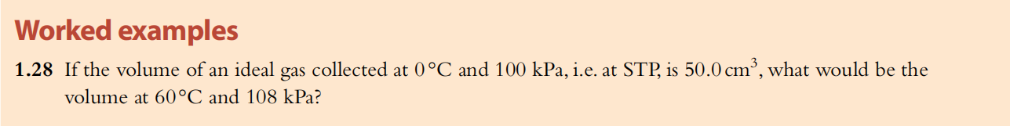
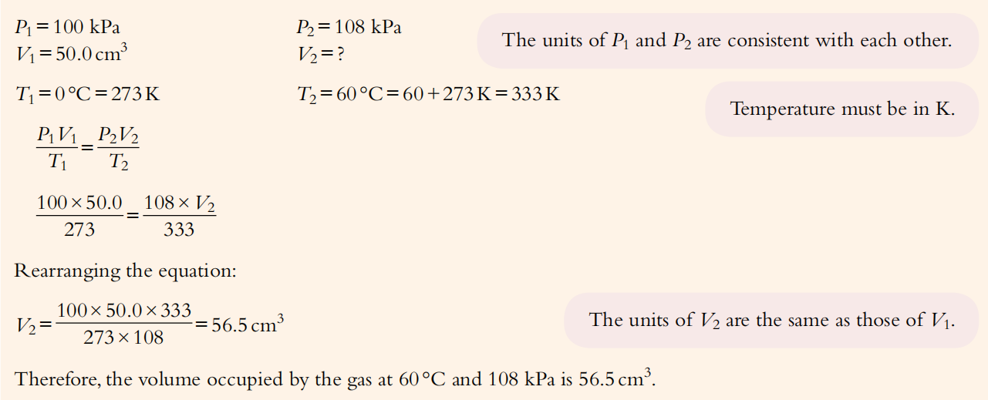

Slide 91
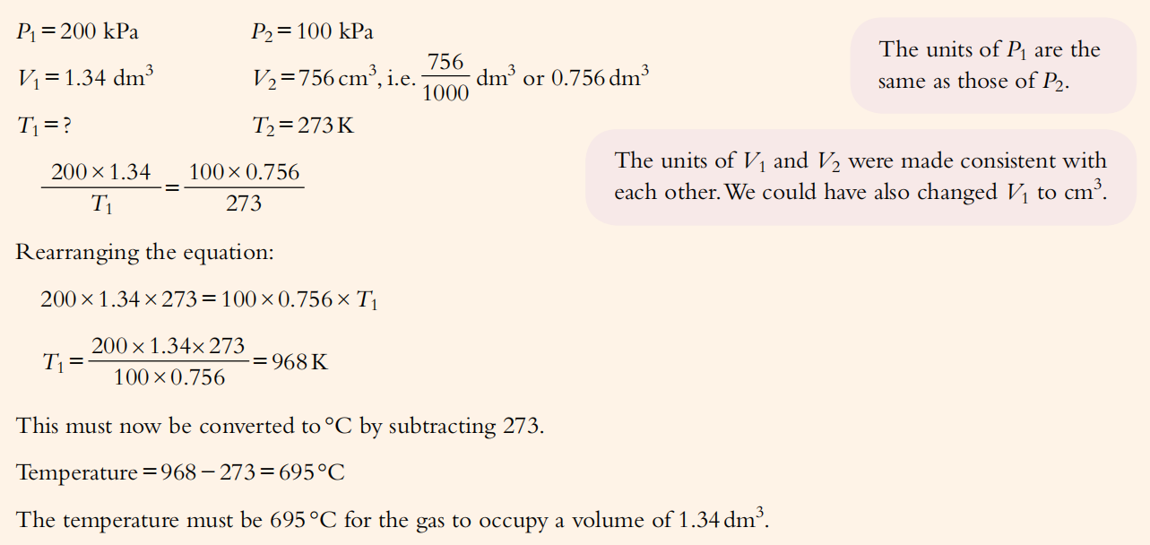

Slide 98
Ideal Gas
An ideal gas is defined as one that obeys the ideal gas law PV = nRT under all conditions.
This means that for one mole of gas, the relationship PV/RT should be equal to 1.
So a graph of PV/RT against P for one mole of an ideal gas is a horizontal line of intercept 1

Slide 99
Two assumptions for ideal gas
There are two assumptions made in describing an ideal gas in the kinetic molecular theory:
1. the volume (or size) of the gas particles is negligible (they are all mass points);
2. there are no attractive forces (intermolecular forces) between the particles.

Slide 100
Real gas deviation
But there is no such thing as an ideal gas.
All gases, known as real gases, deviate to some extent from ideal behaviour. So, for real gases the value of PV/RT for one mole will vary.
An example of the extent of this variation from 1 at different conditions is shown in the following diagram.

Slide 101
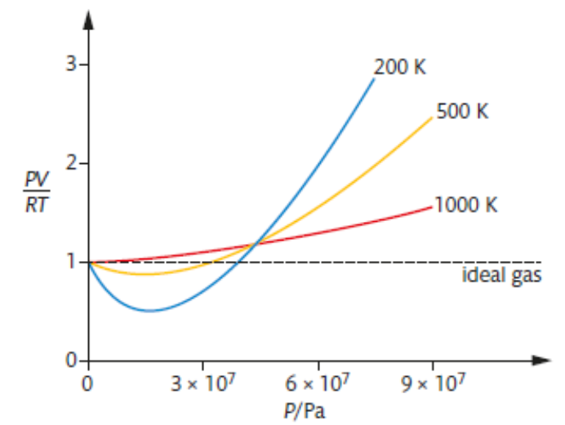

Slide 102
We can draw the following conclusions from the diagram:
The gas behaves most like an ideal gas at low pressure and shows the greatest deviation at high pressure.
The gas behaves most like an ideal gas at high temperature and shows the greatest deviation at low temperature.
To interpret these findings, it will be helpful to question the validity of two assumptions made in describing an ideal gas in the kinetic molecular theory:
1. the volume of the gas particles is negligible;
2. there are no attractive forces between the particles.

Slide 103
1. At relatively low pressure, such as 100 kPa (STP), the volume occupied by the particles of a typical gas is only about 0.05% of the total volume, so it is reasonably valid to describe this as negligible.
But with increasing pressure as the space between the particles is reduced, this percentage increases and with a pressure of 500 kPa, the volume of the particles is about 20% of the total volume – certainly not negligible.
As a result, the volume of a real gas at high pressure is larger than that predicted from the ideal gas law and PV/nRT > 1.

Slide 104
2. When a gas is at moderately low pressure and relatively high temperature, the particles are so widely spaced that interactive forces are highly unlikely, and even if there were some intermolecular forces they would be easily broken due to high kinetic energy, so this assumption is valid.
But at pressures up to about 300 kPa, as the particles approach more closely, attractive forces strengthen between them.
These have the effect of reducing the pressure of the gas, so PV/nRT < 1.
At even higher pressures, the non-zero volume of the particles becomes more important and this effect dominates where the graph rises.
Low temperatures increase this deviation because the lower kinetic energy of the particles increases the strength of intermolecular forces.

Slide 105
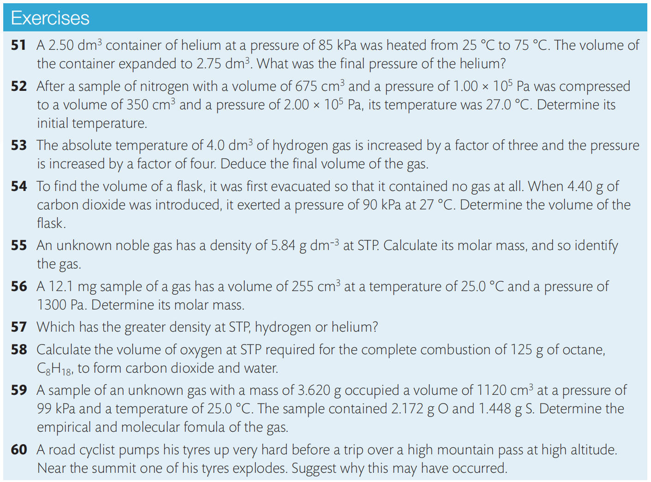

Slide 106
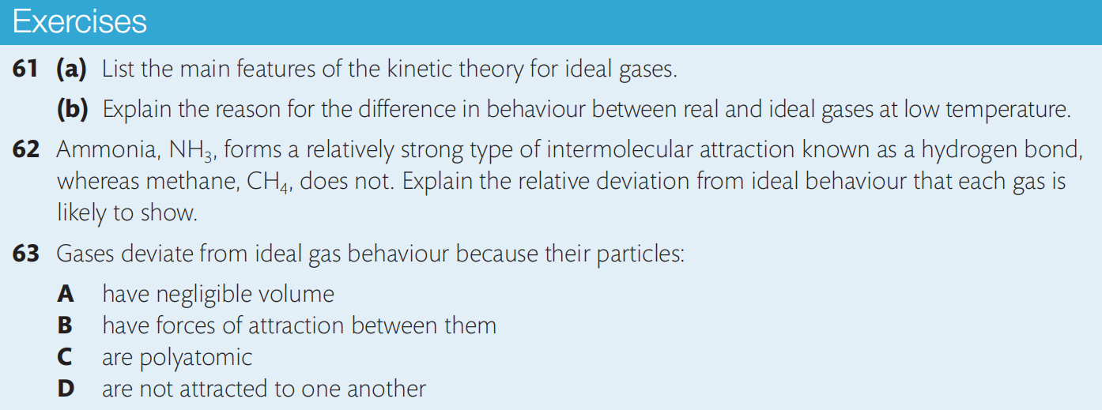

Slide 107
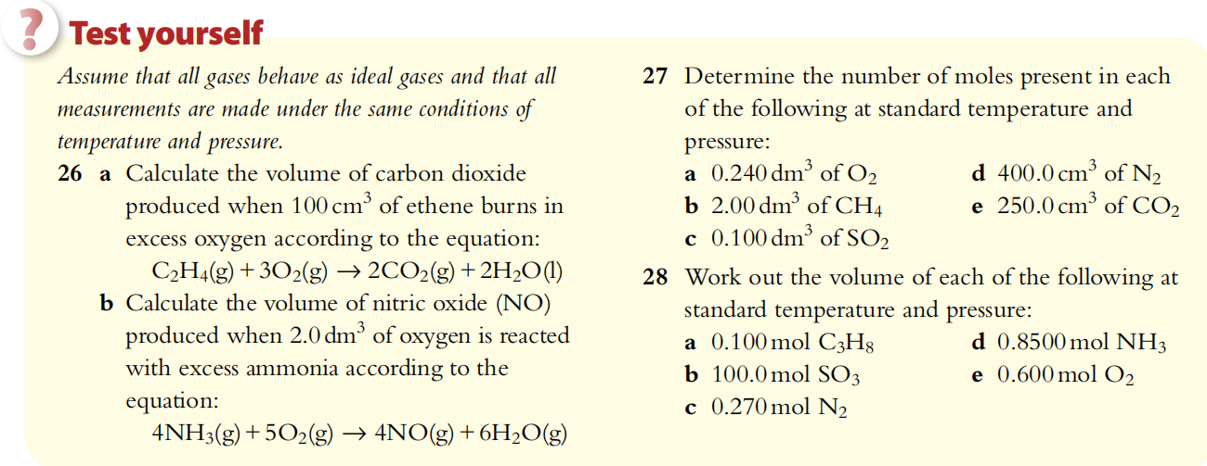
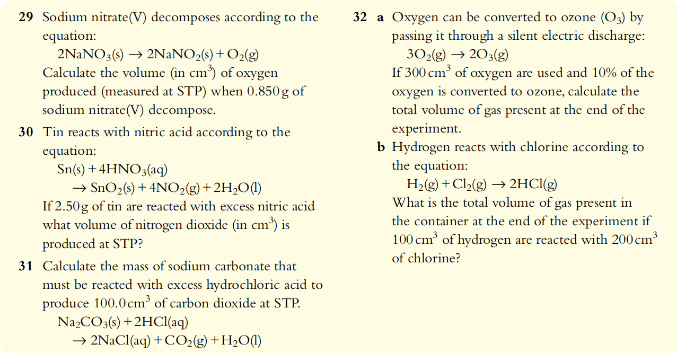

Slide 108
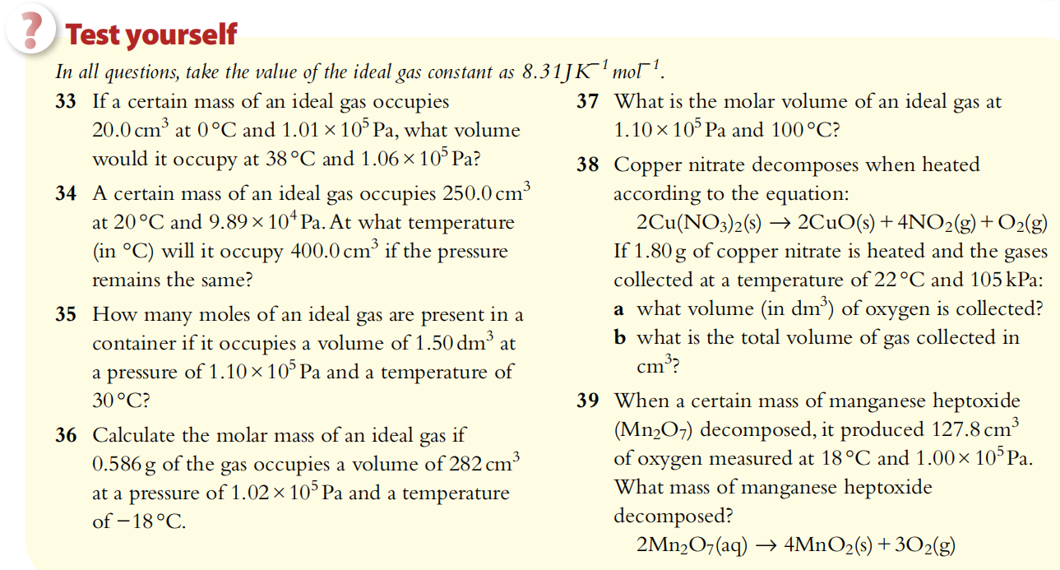

Slide 109
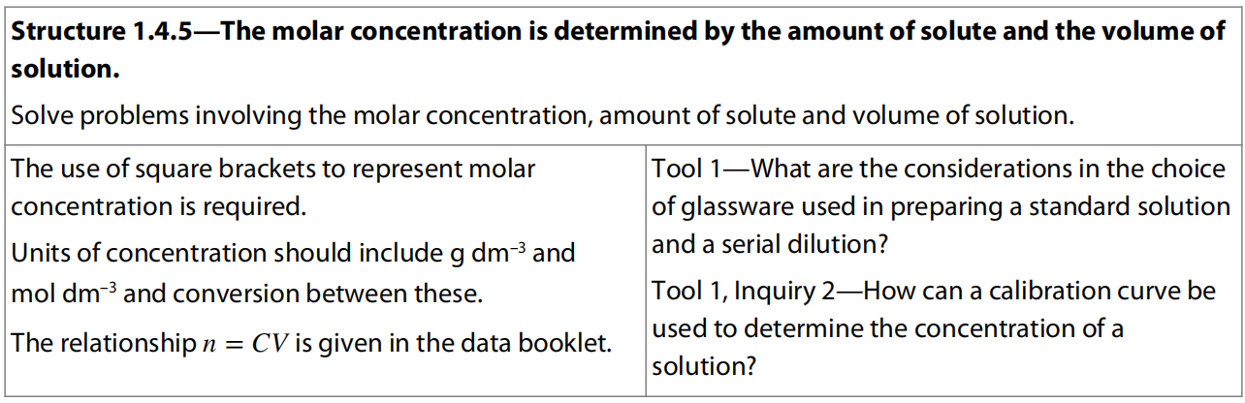
6.4 Molar Concentration in Solution

Slide 110
Solution
A solution is a homogeneous mixture of two or more substances, which may be solids, liquids, or gases, or a combination of these.
The solvent is the component present in the greatest quantity, in which the solute is dissolved.
Some examples of solutions include:
solid/solid: metal alloy such as brass (copper and zinc);
solid/liquid: seawater (salts and water), copper sulfate(aq) (copper sulfate and water);
liquid/liquid: wine (ethanol and water);
gas/liquid: fizzy drinks (carbon dioxide and water).

Slide 111
Molar Concentration of Solution
For solutions, we express the amount through its concentration. The concentration of a solution (c) is determined by the amount of solute (n) and the volume of solution (V).
It is usually expressed as mol dm^{–3}.
concentration of solution (mol dm^{–3})
= amount of solute (mol)/volume of solution (dm³) or
c_{solute} = n_{solute} / V_{solution}
amount of solute (mol) = conc. (mol dm^{–3}) × volume (dm³) or n_{solute} = c_{solute} ・ V_{solution}
Square brackets are often used to represent ‘concentration of’ a particular substance; such as [HCl] = 1.0 mol dm^{–3}.

Slide 112
Mass Concentration of Solution
The composition of a solution is sometimes expressed as the mass concentration, ρ_{solute}, of the solute, which is the ratio of the mass of the solute to the volume of the solution:
ρ_{solute} = m_{solute} / V_{solution}
The most common units for mass concentration are g dm^{–3} and g cm^{–3}. Mass concentration and molar concentration of the same solute are related by molar mass, as follows:
c_{solute} = ρ_{solute} / M_{solute}

Slide 113
Standard Solution
Chemists routinely prepare solutions of known concentration, known as standard solutions.
The mass of solute required is accurately measured and then transferred carefully to a volumetric flask, which is accurately calibrated for a specific volume.
The solvent is added steadily with swirling to help the solute to dissolve, until the final level reaches the mark on the flask horizontally.

Slide 117
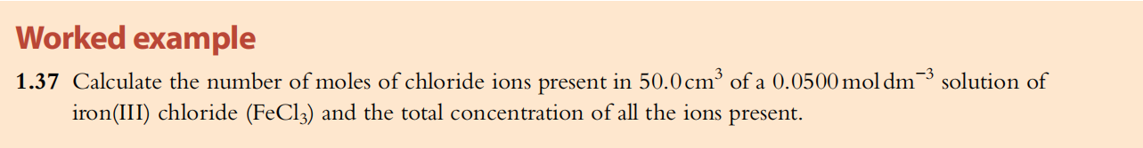
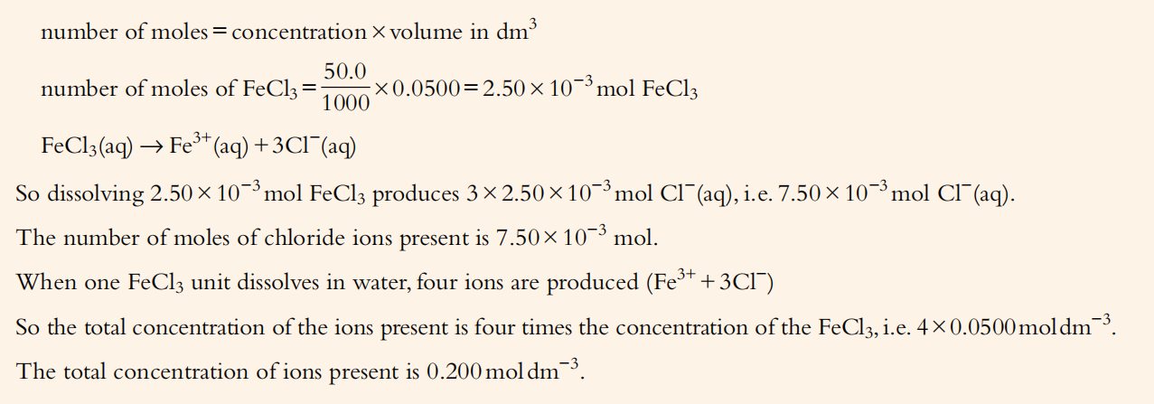

Slide 118
Dilutions of solutions
A common practice in laboratory work is to make a dilution from a more concentrated starting solution by adding solvent.
For all aqueous solutions, distilled water, rather than tap water, must be used.
As a solution is diluted, the number of moles of solute remains the same, but as they become spread through a larger volume, the concentration is decreased.
In other words, the number of moles, n = a constant, and as n=cV , cV must be constant through dilution.
c₁V₁ = c₂V₂ where c₁ and V₁ refer to the initial concentration and volume and c₂ and V₂ refer to the diluted concentration and volume.
This equation provides an easy way to calculate concentration changes on dilution.

Slide 120
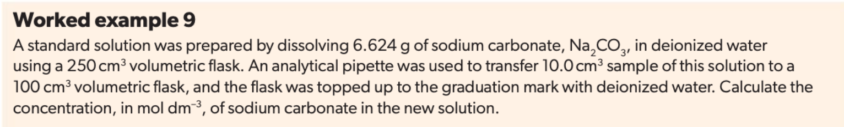
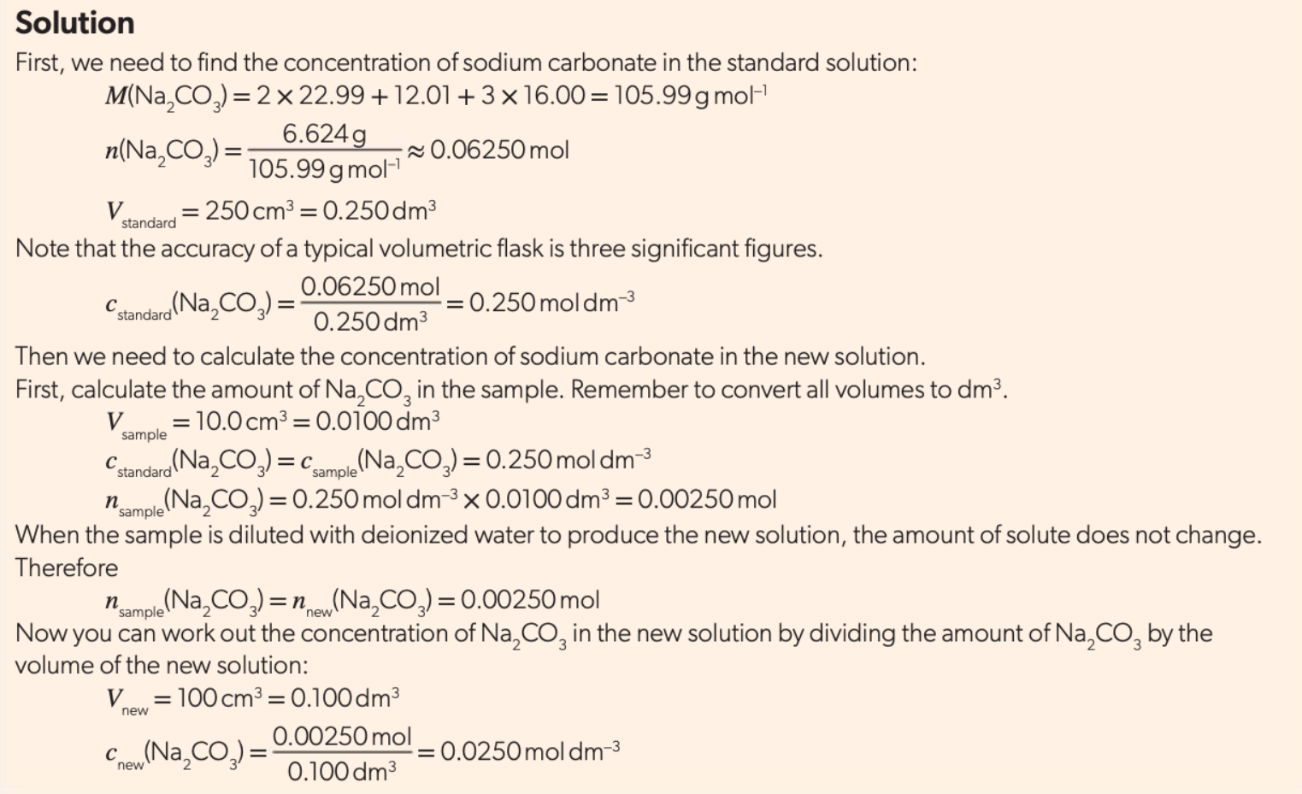

Slide 121
Volumetric Analysis
From the stoichiometry of the reaction, when we know the volumes of both solutions and the concentration of one of them, we can use the mole ratio to calculate the unknown concentration as follows.

Slide 122
Titration
Most commonly, a technique called titration is used to determine the reacting volumes precisely.
A pipette is used to measure a known volume of one of the solutions into a conical flask.
The other solution is put into a burette, a calibrated glass tube that can deliver precise volumes into the conical flask through opening the tap at the bottom.
The point at which the two solutions have reacted completely, the equivalence point, is usually determined by an indicator that is added to the solution in the conical flask and changes colour at its end-point.
Different indicators are chosen for specific titrations, so that their end-point corresponds to the equivalence point of the titration.

Slide 123
Titration usually involves multiple trials to obtain a more accurate result of the volume required to reach the equivalence point; this volume is known as the titre.
A good titration result is one that gives consistent results within 0.05 cm³ of each other.

Slide 124
Acid-Base Titration
coefficient 2 1
mole 0.02500×0.100 0.01520× c_{H2SO4}
0.02500×0.100 0.01520× c_{H2SO4}
=
2 1

Slide 126
Here is a summary of the steps in volumetric analysis calculations:
first write the equation for the reaction;
look for the reactant whose volume and concentration are given and calculate its number of moles from n = cV;
use this answer and the mole ratio in the equation to determine the number of moles of the other reactant;
use the number of moles and volume of the second reactant to calculate its concentration from c = n/V.

Slide 127
Back Titration
A back titration is done in reverse by returning to the end-point after it is passed.
It is used when the end-point is hard to identify or when one of the reactants is impure.
A known excess of one of the reagents is added to the reaction mixture, and the unreacted excess is then determined by titration against a standard solution.
By subtracting the amount of unreacted reactant from the original amount used, the reacting amount can be determined.

Slide 129
Note that there are several assumptions made in this calculation. These include the fact that all the NaHCO₃ did react with the acid, and that the only component of the tablet that reacted with HCl is NaHCO₃.
You may like to think how you could test the validity of these assumptions in the laboratory.

Slide 130
Redox titrations
As acid–base titrations does, redox titrations are used to determine the unknown concentration of a substance in solution.
But in this case, the technique is based on a redox reaction between the two reactants, and finds the equivalence point where they have reacted stoichiometrically by transferring electrons.

Slide 131
Redox titrations are carried out in much the same way as acid–base titrations, using a burette and pipette to measure volumes accurately, and a standard solution of one reactant.
An indicator is usually used to signal the equivalence point, although some redox changes are accompanied by a colour change and may not need an external indicator (e.g. purple MnO₄⁻ → colorless Mn²⁺).

Slide 132
From the volume of the solution added from the burette to reach equivalence, which is known as the titre, the concentration of the other reactant can be determined.
The calculations are based on the redox equation.
Redox titrations are commonly used in the food and beverages industry, in the pharmaceutical industry, and in water and environmental analysis.
For example, wines can be analyzed for the presence of sulfur dioxide, and the vitamin C content of foods can be determined in this way.

Slide 133
Examples of common redox titrations
Analysis of iron with manganate (VII)
The reaction is accompanied by a colour change from deep purple to colourless, so the reaction acts as its own indicator, signaling the equivalence point.

Slide 137
Iodine–thiosulfate reaction
Several different redox titrations use an oxidizing agent to react with excess iodide ions to form iodine.
Examples of oxidizing agents used in this way include KMnO₄, KIO₃, K₂Cr₂O₇, and NaOCl.
The liberated iodine, I₂, is then titrated with sodium thiosulfate, Na₂S₂O₃, using starch as an indicator.

Slide 138
The starch indicator is added during the titration (not at the start) and forms a deep blue colour by forming a complex with free I₂.
As the I₂ is reduced to I– during the reaction, the blue colour disappears, marking the equivalence point.

Slide 142
Winkler method for calculating dissolved oxygen
The dissolved oxygen (DO) content of water is one of the most important indicators of its quality, as oxygen is essential to the survival of aquatic life.
As the level of pollution in water increases, the dissolved oxygen content generally decreases, as the oxygen is used by bacteria in decomposition reactions.

Slide 143
A canal in England covered in a bloom of duckweed.
This is an aquatic weed that thrives in water that contains pollutants such as phosphates.
This is known as eutrophication.
The bloom blocks out sunlight to deeper layers of the water ecosystem, and so lowers the level of dissolved oxygen.

Slide 144
The biological oxygen demand (BOD) is therefore used as a means of measuring the degree of pollution.
BOD is defined as the amount of oxygen used to decompose the organic matter in a sample of water over a specified time period (usually five days) at a specified temperature.
A high BOD indicates a greater quantity of degradable organic waste in the water, which means a lower level of dissolved oxygen.

Slide 145
Redox titrations can be used to measure the dissolved oxygen in water, and from this calculate the BOD in a process known as the Winkler method.
The principle is based on a sequence of redox reactions as follows.

Slide 146
The dissolved oxygen, O₂ (g), in the water is ‘ fixed’ by the addition of a manganese(II) salt such as MnSO4. Reaction of this salt with O2 in basic solution causes oxidation of Mn(II) to higher oxidation states, such as Mn(IV):
2 Mn²⁺ (aq) + O₂ (g) + 4 OH– (aq) → 2 MnO₂ (s) + 2 H₂O (l)
Acidified iodide ions, I–, are added to the solution, and are oxidized by the Mn(IV) to I₂:
MnO₂ (s) + 2 I– (aq) + 4 H⁺ (aq) → Mn²⁺ (aq) + I₂ (aq) + 2 H₂O (l)
The iodine produced is then titrated with sodium thiosulfate, as described earlier:
2 S₂O₃^{2–} (aq) + I₂ (aq) → 2 I– (aq) + S₄O₆^{2–} (aq)
So we can see that in the overall sequence, for every 1 mole of O₂ in the water, 4 mol of S₂O₃^{2–} are used.

Slide 148
3.125

Slide 149
3.125
3.125
1.562
1.562
5.000
0.0100

Slide 150
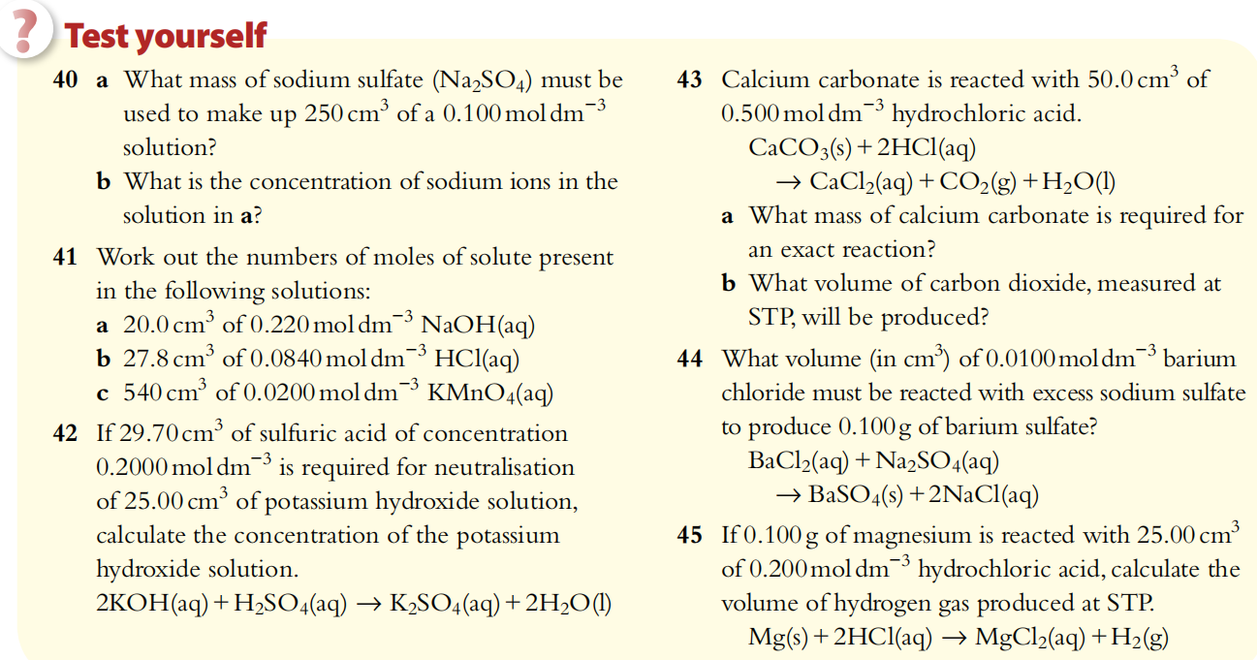

Slide 151
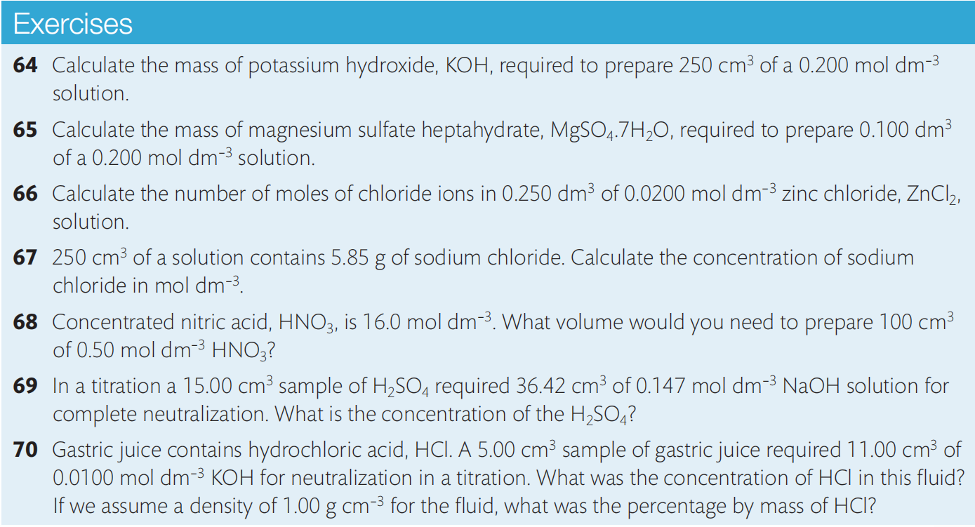
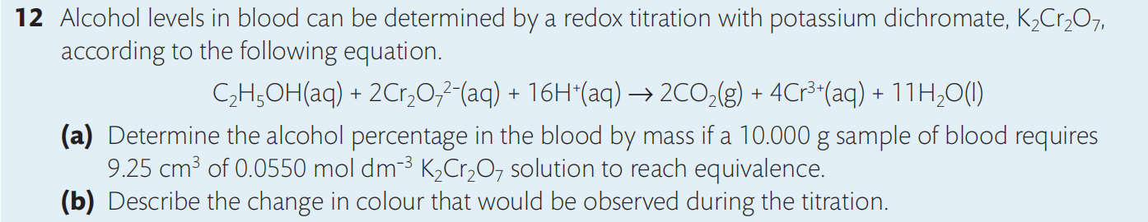

Slide 152
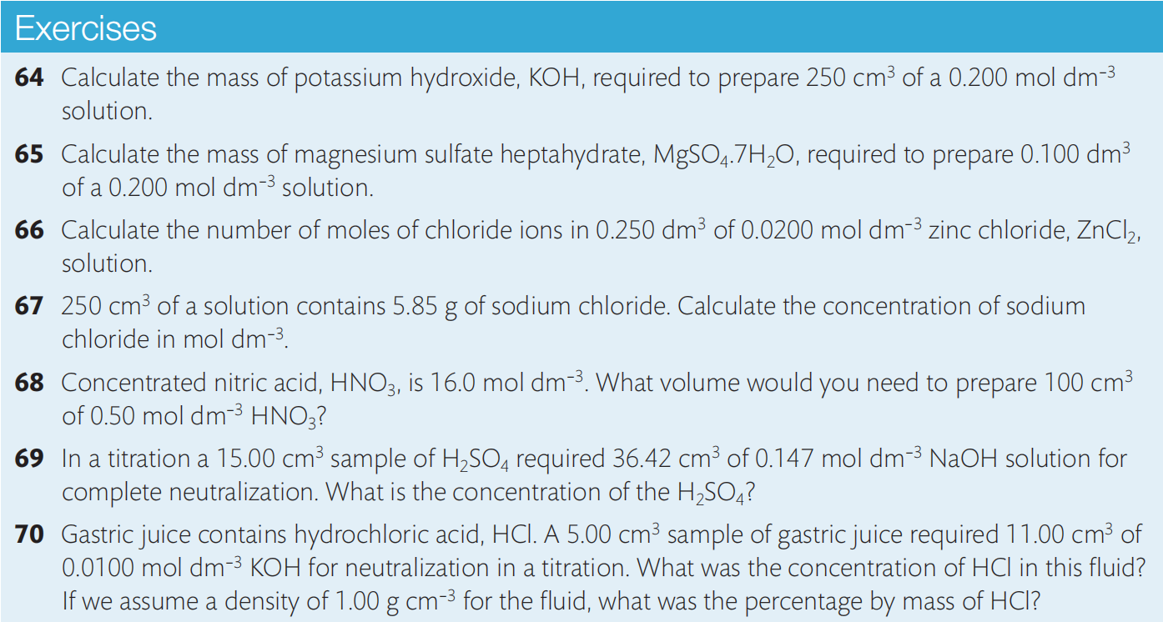
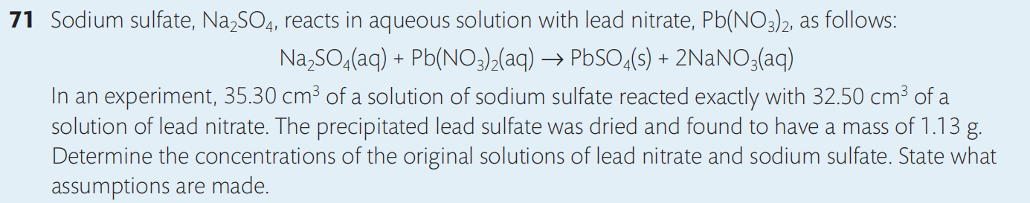

Slide 153
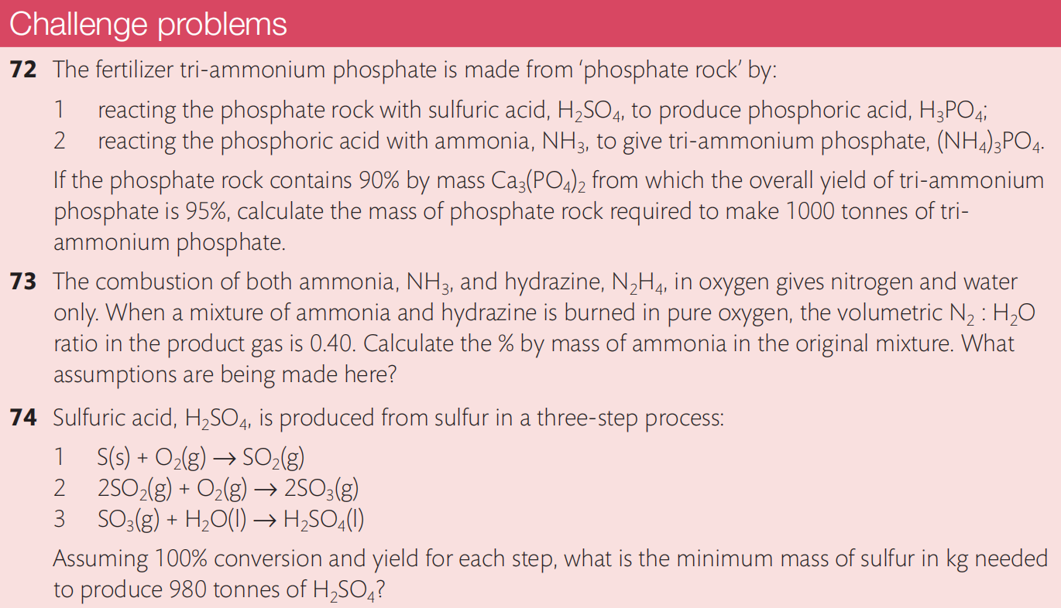

Slide 154
